Slide 1
Some fundamental economic forces in marketing
A profit function of profit margin and sales volume
Long tail
Bad money drives out good
Externality and network effects

Slide 2
Let’s start with some math
Profit = Profit margin * Sales volume
promotion:
a booster
product
quality & pricing
product accessibility
Low quality and low price for the masses big sale volume
High quality and premium price for the rich limited sale volume
Trade-off:
which once is more cost effective?

Slide 3
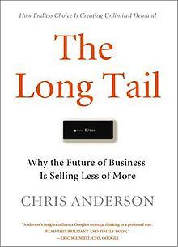
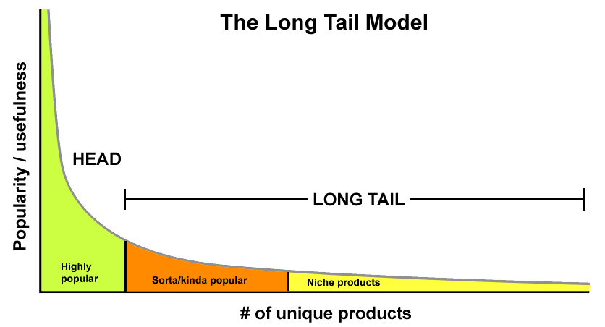
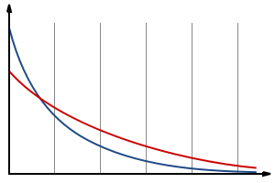
The tail becomes bigger and longer in new markets (depicted in red). In other words, whereas traditional retailers have focused on the area to the left of the chart, online bookstores derive more sales from the area to the right.
In which market is doing business easier?

Slide 4
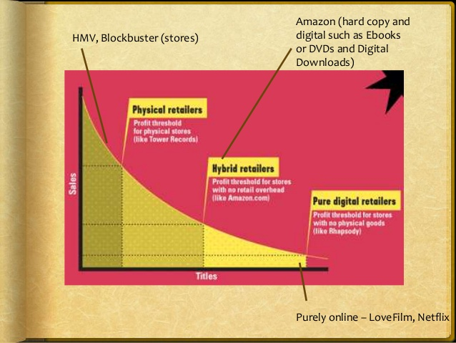

Slide 5



"Bad Money Drives Out Good"
(Gresham’s Law)
Information asymmetry

Slide 6

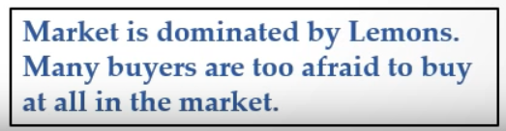
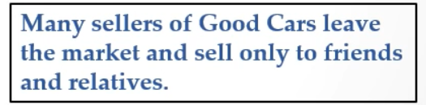
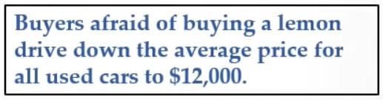
"Bad Money Drives Out Good"
an “average” price of $12,500
Information Asymmetry
Buyers may not like to pay the avg. price of $12,500 if they are risk averse

Slide 7
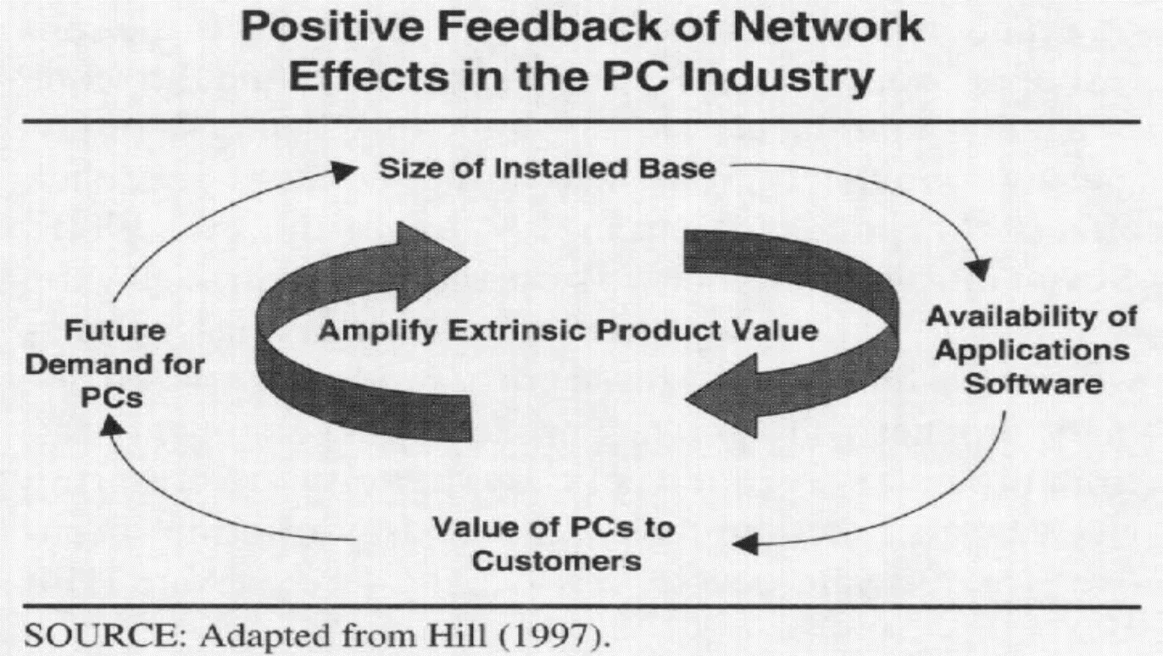
Externality: Network Effects
Direct network effect is the increase in utility of a product as the number of users increases (e.g., telephones, fax machines).
Indirect network effect is the increase in utility of a product as the number of associated accessories to that product increases.

Slide 8

Coexistence of several network effects:

Slide 9

Can you identify some direct and in-direct network effects that may influence users’ choices?
Can you use the notions we just discussed to explain some observations in marketing?
WhatsApp vs. WeChat
Free products and versioning, etc.

Slide 10
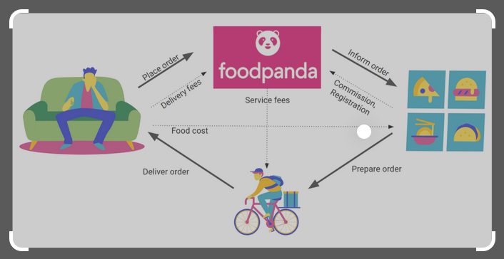
Two-sided markets
Examples:
Matchmaking: match both males and females to date
Crowdfunding: attract both campaign creators and backers (buyers & donors)
Ride-hailing: drivers and passengers
ride- and office-sharing, and other sharing economy

Slide 11
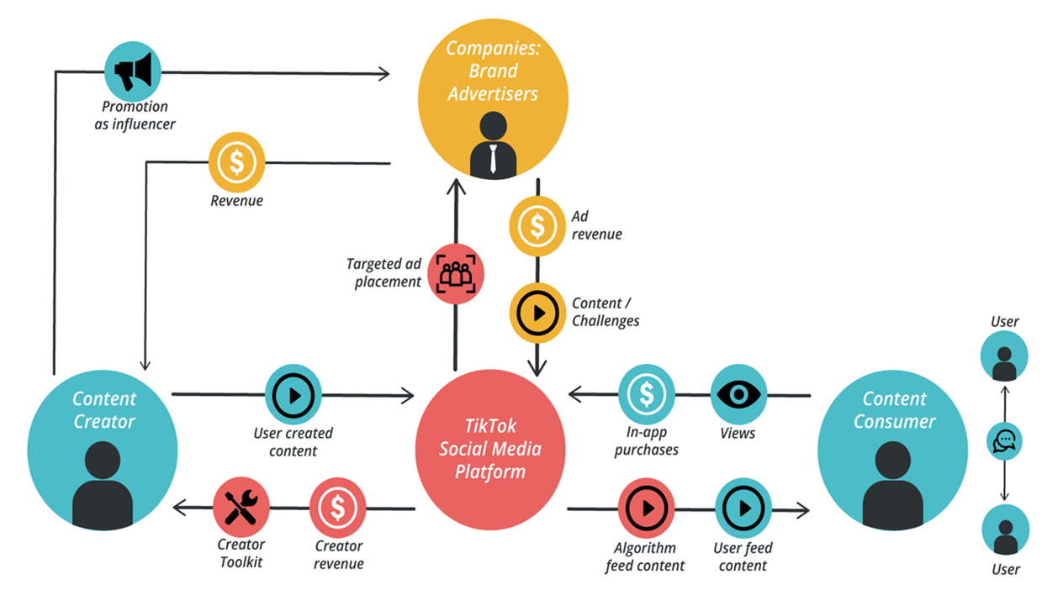
Positive cross-side network effects (sequential and simultaneous moves)
More competition among participants on the same side
Increased heterogeneity in participants’ preferences
Change in participants’ composition
Higher cost of matching the two sides
Effective matching becomes one of a platform’s core competences

